Slide 1
假设有一GPS时间：WN=1939;Tow=4.489710999816656e+05;
又有闰秒列表（每一行7列，前面6列代表闰秒发生的时刻，最后一列到这一时刻总共的闰秒数）：
leapsec=[2017,1,1,0,0,0,-18;2015,7,1,0,0,0,-17;2012,7,1,0,0,0,-16;2009,1,1,0,0,0,-15;2006,1,1,0,0,0,-14;1999,1,1,0,0,0,-13; ...
1997,7,1,0,0,0,-12;1996,1,1,0,0,0,-11;1994,7,1,0,0,0,-10;1993,7,1,0,0,0,-9; ...
1992,7,1,0,0,0,-8;1991,1,1,0,0,0,-7;1990,1,1,0,0,0,-6;1988,1,1,0,0,0,-5; ...
1985,7,1,0,0,0,-4;1983,7,1,0,0,0,-3;1982,7,1,0,0,0,-2;1981,7,1,0,0,0,-1];
请用matlab程序求出以历法形式表达的UTC时间。（提示：可以使用datenum
datevec函数）

Slide 2
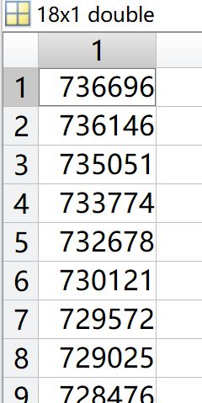
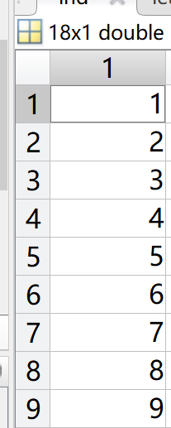
ori=datenum(1980,1,6,0,0,0);
WN=1939;
Tow=4.489710999816656e+05;
leapsec=[2017,1,1,0,0,0,-18;2015,7,1,0,0,0,-17;2012,7,1,0,0,0,-16;2009,1,1,0,0,0,-15;2006,1,1,0,0,0,-14;1999,1,1,0,0,0,-13; ...
1997,7,1,0,0,0,-12;1996,1,1,0,0,0,-11;1994,7,1,0,0,0,-10;1993,7,1,0,0,0,-9; ...
1992,7,1,0,0,0,-8;1991,1,1,0,0,0,-7;1990,1,1,0,0,0,-6;1988,1,1,0,0,0,-5; ...
1985,7,1,0,0,0,-4;1983,7,1,0,0,0,-3;1982,7,1,0,0,0,-2;1981,7,1,0,0,0,-1];
gpst=ori+WN*7+Tow/3600/24;
leaps=datenum(leapsec(:,1:6));
ori=datenum(1980,1,6,0,0,0);
gpst=ori+WN*7+Tow/3600/24;
leaps=datenum(leapsec(:,1:6));
ind=find(leaps<gpst);
utcday=gpst+leapsec(ind(1),7)/3600/24;
utcdate=datevec(utcday);
ind=find(leaps<gpst);
utcday=gpst+leapsec(ind(1),7)/3600/24;
utcdate=datevec(utcday);

